Slide 1
KEYLOGGER
NAAN MUDALVAN PROJECT
Presented By:
Puvis K- COLLEGE OF ENGINEERING GUINDY ANNA UNIVERSITY – BE COMPUTER SCIENCE AND ENGG

Slide 2
OUTLINE
Problem Statement Proposed System/Solution
System Development Approach
Algorithm & Deployment
Result (Output Image)
Conclusion
Future Scope
References

Slide 3
Problem Statement
In today's digital age, the prevalence of cybersecurity threats continues to escalate, posing significant risks to individuals and organizations alike. Among these threats, the proliferation of keyloggers presents a formidable challenge, compromising sensitive information and undermining data security measures. Keyloggers, whether in the form of hardware or software, clandestinely record keystrokes made by users, enabling malicious actors to capture passwords, credit card numbers, and other confidential data without detection. This insidious tactic jeopardizes personal privacy, financial security, and organizational integrity, necessitating urgent attention and robust countermeasures to mitigate the pervasive threat of keylogging attacks.

Slide 4
Proposed Solution
1. Endpoint Security Software: Deploy advanced endpoint security solutions equipped with anti-keylogging capabilities to detect and block malicious keylogger activities in real-time.
2. Employee Training and Awareness: Conduct regular cybersecurity training sessions to educate employees about the risks of keylogging attacks and promote best practices for safeguarding sensitive information.
3. Multi-Factor Authentication (MFA): Implement MFA protocols to add an extra layer of protection against unauthorized access, reducing the impact of keyloggers even if credentials are compromised.
4. Encryption Technologies: Utilize encryption techniques to secure sensitive data both in transit and at rest, minimizing the risk of data interception and unauthorized access by keyloggers.
5. Continuous Monitoring and Detection: Employ robust monitoring tools and intrusion detection systems to continuously monitor network activity and identify potential signs of keylogging activity or other malicious behavior.
6. Regular Software Updates and Patch Management: Ensure that all software applications, operating systems, and security tools are kept up-to-date with the latest patches and security updates to mitigate vulnerabilities exploited by keyloggers.
By implementing these proactive measures, organizations can fortify their defenses against keylogging attacks and mitigate the risks associated with unauthorized data interception and theft.

Slide 5
System Approach
- Identification: Assess vulnerabilities and entry points susceptible to keylogging attacks.
- Prevention: Deploy endpoint security solutions, enforce access controls, and implement secure authentication mechanisms.
- Detection: Utilize robust monitoring tools and anomaly detection systems to identify suspicious activities indicative of keylogging.
- Response: Develop incident response protocols for rapid containment and remediation of keylogging incidents.
- Recovery: Establish recovery mechanisms and backup strategies to restore compromised systems and data integrity.
- Continuous Improvement: Evaluate and refine security measures based on emerging threats and industry best practices.

Slide 6
Algorithm & Deployment
- Algorithm Selection: Choose machine learning algorithms suitable for keylogger detection, such as anomaly detection techniques or supervised learning models trained on labeled datasets.
- Model Training: Train the selected machine learning model using historical data on keystroke patterns and behaviors to distinguish between normal and malicious activity.
- Deployment Architecture: Design a scalable and resilient deployment architecture for hosting the keylogger detection model, considering factors such as performance, scalability, and fault tolerance.
- Integration: Integrate the trained model into existing security infrastructure, such as endpoint security solutions or network monitoring systems, to enable real-time detection and response to keylogging threats.
- Monitoring and Maintenance: Implement monitoring mechanisms to track the performance and effectiveness of the deployed model over time, conducting regular maintenance and updates as needed to ensure optimal functionality and accuracy.
- Continuous Improvement: Continuously evaluate and refine the deployed algorithm based on feedback and new data, incorporating insights gained from incident response and threat intelligence to enhance detection capabilities and adapt to evolving threats.

Slide 7
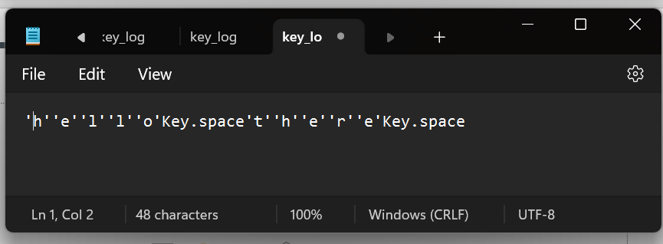
Result

Slide 8
Conclusion
- Keyloggers pose a significant threat to data security and privacy, necessitating proactive defense measures.
- A systematic approach incorporating identification, prevention, detection, response, recovery, and continuous improvement is crucial for effective mitigation.
- Deployment of advanced machine learning algorithms enables real-time detection and response to keylogging attacks.
- Ongoing vigilance, monitoring, and adaptation to emerging threats are essential for maintaining resilience against evolving cyber threats.

Slide 9
Future scope
- Advancements in Machine Learning: Continued improvements in machine learning algorithms will enhance keylogger detection accuracy.
- Integration with Emerging Technologies: Integration with blockchain, edge computing, and AI will strengthen defense capabilities.
- Enhanced User Education: Increasing user education about keylogger threats will be crucial for prevention.
- Collaboration and Information Sharing: Collaborative efforts and information sharing will facilitate more effective response strategies.

Slide 10
References
TechTrainer20. (2024). TNSDC Repository. Retrieved from https://github.com/techtrainer20/TNSDC

Slide 11
THANK YOU

